Slide 1
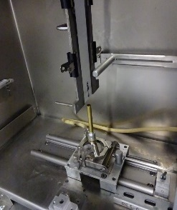
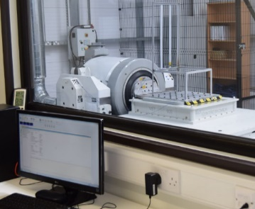
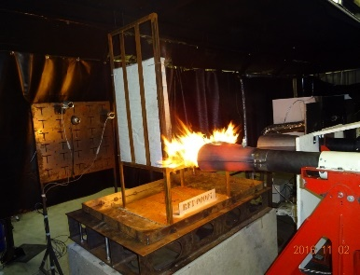
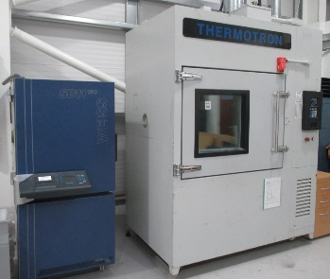
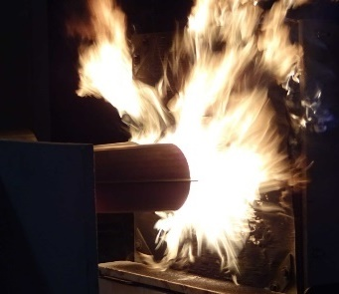
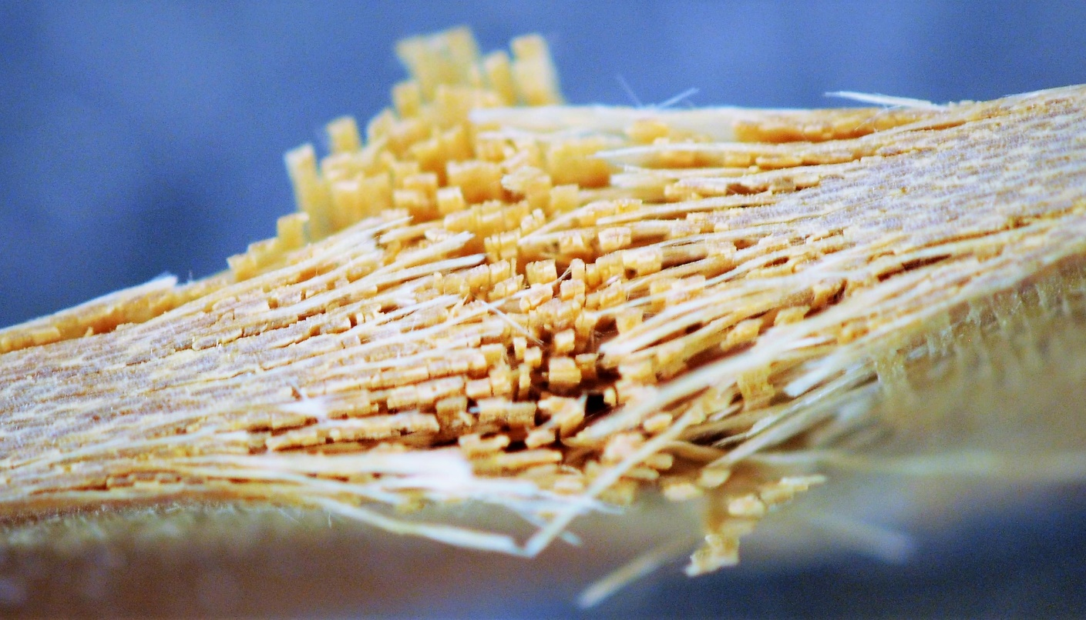

FAA Conference 2019
Comparative Review of Kerosene Burners via an Assessment of the Post-test Material Allowable of Composite Panels
2018-12-05

Slide 2
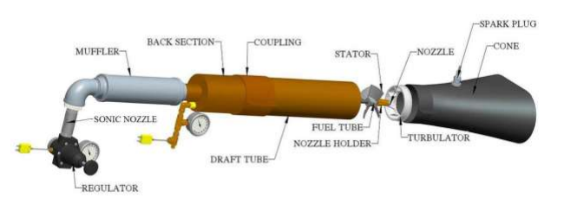
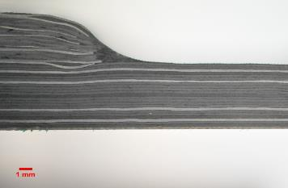
Introduction
This project was planned to have completed its first phase and was to be funded under a European initiative fund ‘Fusion’.
Unfortunately due to circumstances and uncertainties beyond our control, funding has been stalled and not released.
The aim of the project is to investigate the deterioration of mechanical properties of composite materials due to fire damage.
This will be achieved by manufacturing 2 composite panels in parallel. One of these panels will be tested to achieve baseline mechanical properties. The second panel will be tested after being subjected to fire damage.
2
Notes:
2

Slide 3
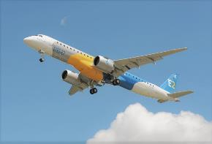

MATERIALS
There are 2 proposed materials for this project; they are used in different applications of the composites industry. Both these materials are Carbon Fibre & Thermoset resin and are readily available at ÉireComposites.
Aerospace Grade Material
Cytec: HMF-5-133/34 (Toray T300B 3K Type 3,
Class 2 Style 3K-135-8H)
Renewable Energy Grade Material
Panex 35, Powder Epoxy
3
Notes:
3

Slide 4
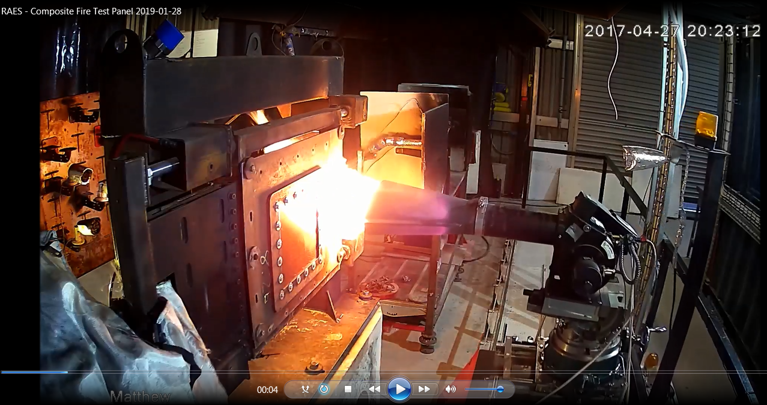
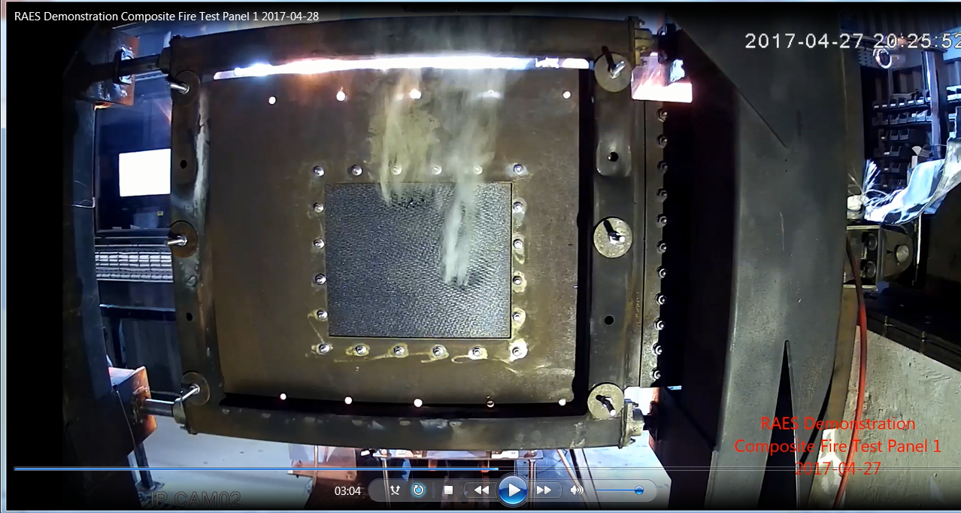
,
Both resonate testing burners
Carlin and Sonic, will be used within this testing. The aim is to understand whether we can see a difference in panel deterioration
Aft face of the panel shall be instrumented to gather as much thermal data as possible.

Slide 5
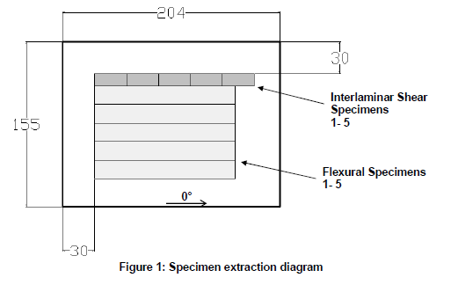
MECHANICAL TESTS
Due to the extreme nature of fire damage to composite materials, it is proposed to keep the test plan simple.
A large amount of damage to the material would make machining and testing complex specimens impossible.
Test Specimens
5 x Flexure test to ISO 14125 (1998)
5 x Interlaminar Shear test to ISO 14130 (1998)
Proposed Tests:
Flexure
Interlaminar Shear
Specimen Extraction Diagram
Interlaminar Shear test set up
5
Notes:
5

Slide 6
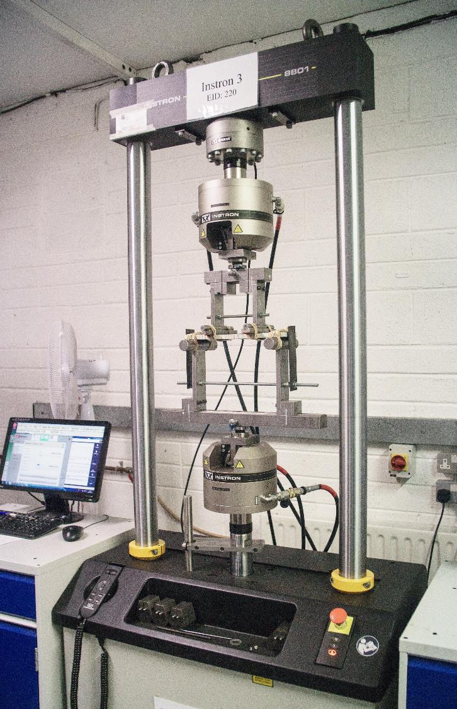

Thank You
Testing@ctlcomposites.com
www.ctlcomposites.com
+353-91-505430
Notes:
6

